Slide 1
Battery Management System based on Cloud Computing
Mohamed Elsyed

Slide 2
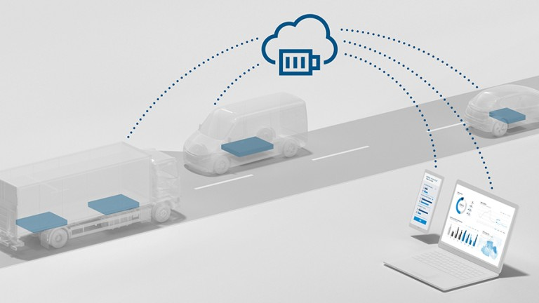
Agenda
What could battery management is.
Achieved work.
Next task.

Slide 3
What could battery management is.

Slide 4
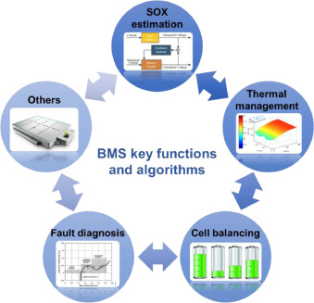
Could battery management

Slide 5
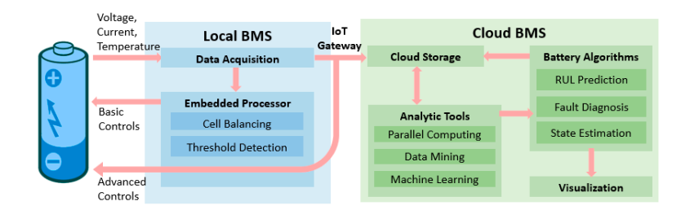
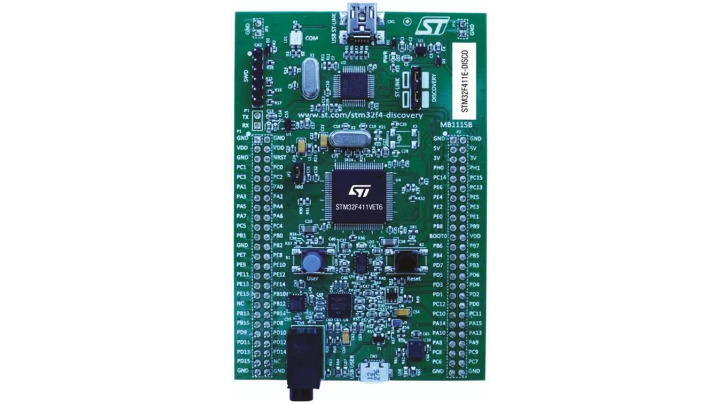
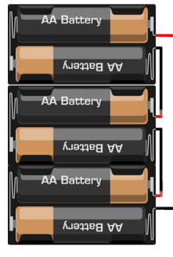
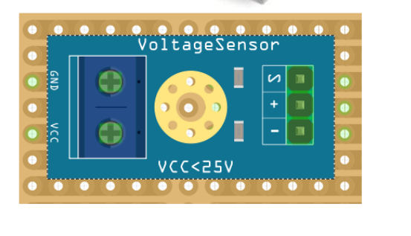
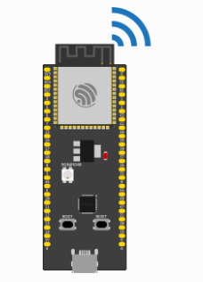
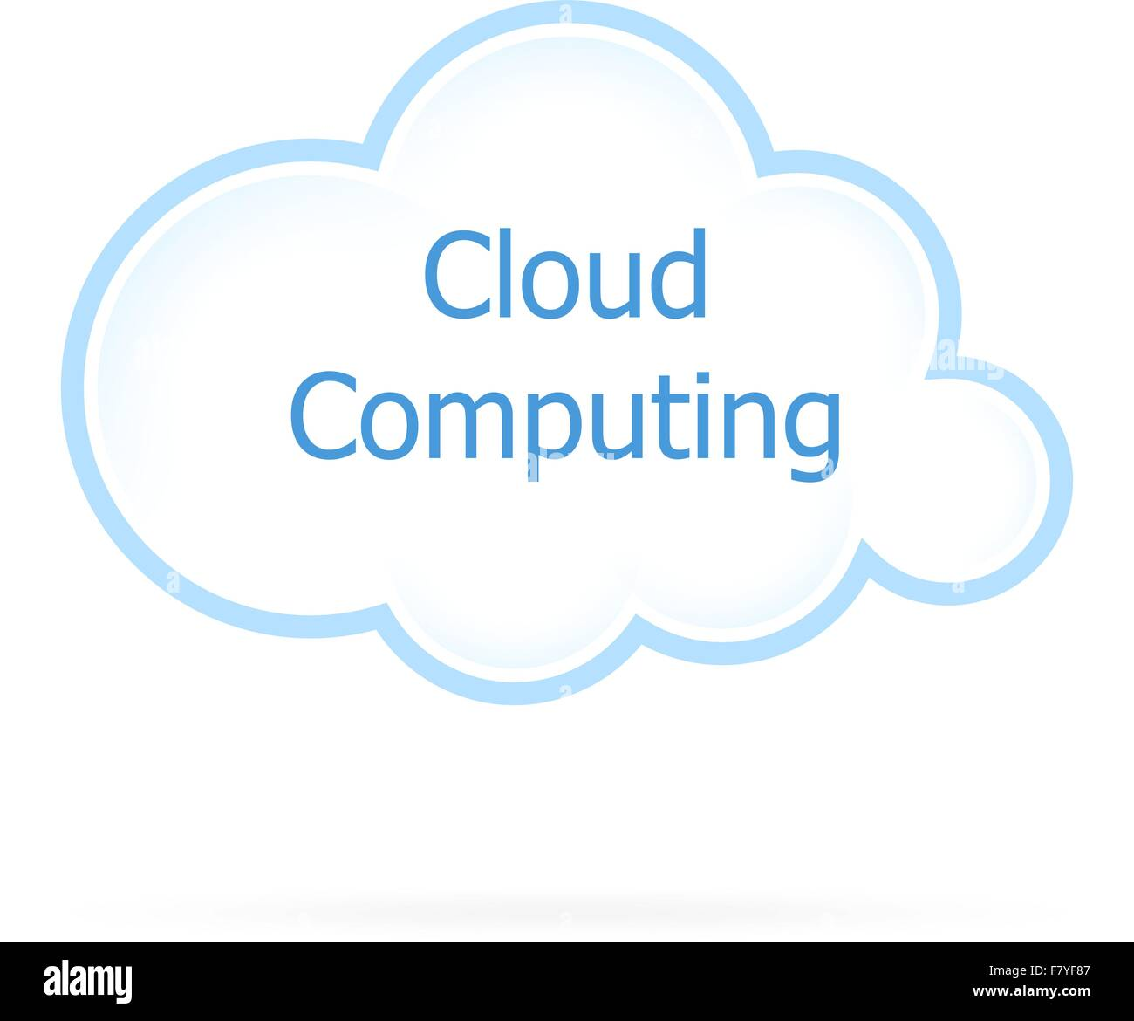
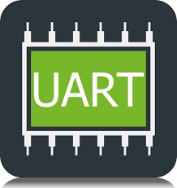
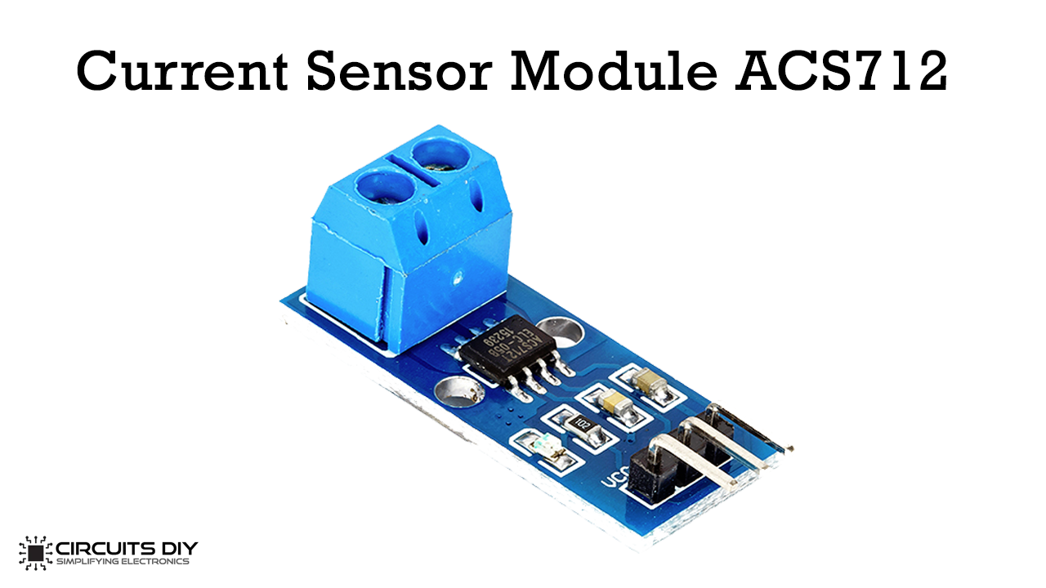

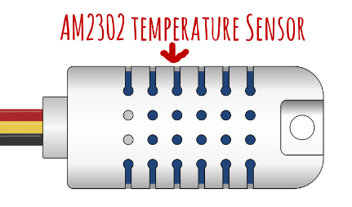
Could battery management
communication protocol

Slide 6

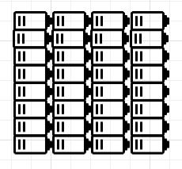
STM32
Microcontroller
ESP32
Current, Voltage, and Temperature Sensors
Measurements: Current,
Voltage, and Temperature
Current, Voltage, and
Temperature using UART

Slide 7

STM32
Microcontroller
ESP32
The decisions received
from the Cloud via UART
The decisions token sent
via MQTT from the Cloud
Cloud Computing

Slide 8
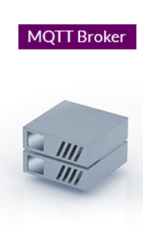



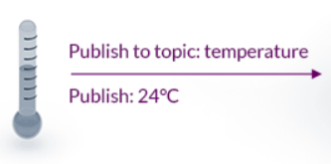
Message Queuing Telemetry Transport(MQTT):
Machine to machine network protocol.
Bi-directional Communications (publish-subscribe).
Scale to Millions of Things.
Broker and many clients
subscribe to topic: temperature
subscribe: 24°C
subscribe to topic: Fan
subscribe: Fan ON
subscribe to topic: temperature
subscribe: 24°C
subscribe to topic: Fan
subscribe: Fan ON
Publish to topic: Fan
Publish: Fan ON

Slide 9

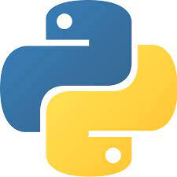

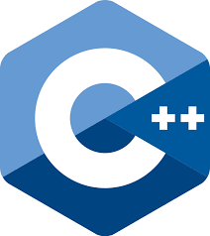
The used programing languages
Why to many Programming languages:
Every languages is the easiest way to run on its environment e.g., python for Cloud.
For me, to learn more.

Slide 10
Questions:
Table of content
Code implememtaion?
Cover design

Slide 11
Achieved work.

Slide 12
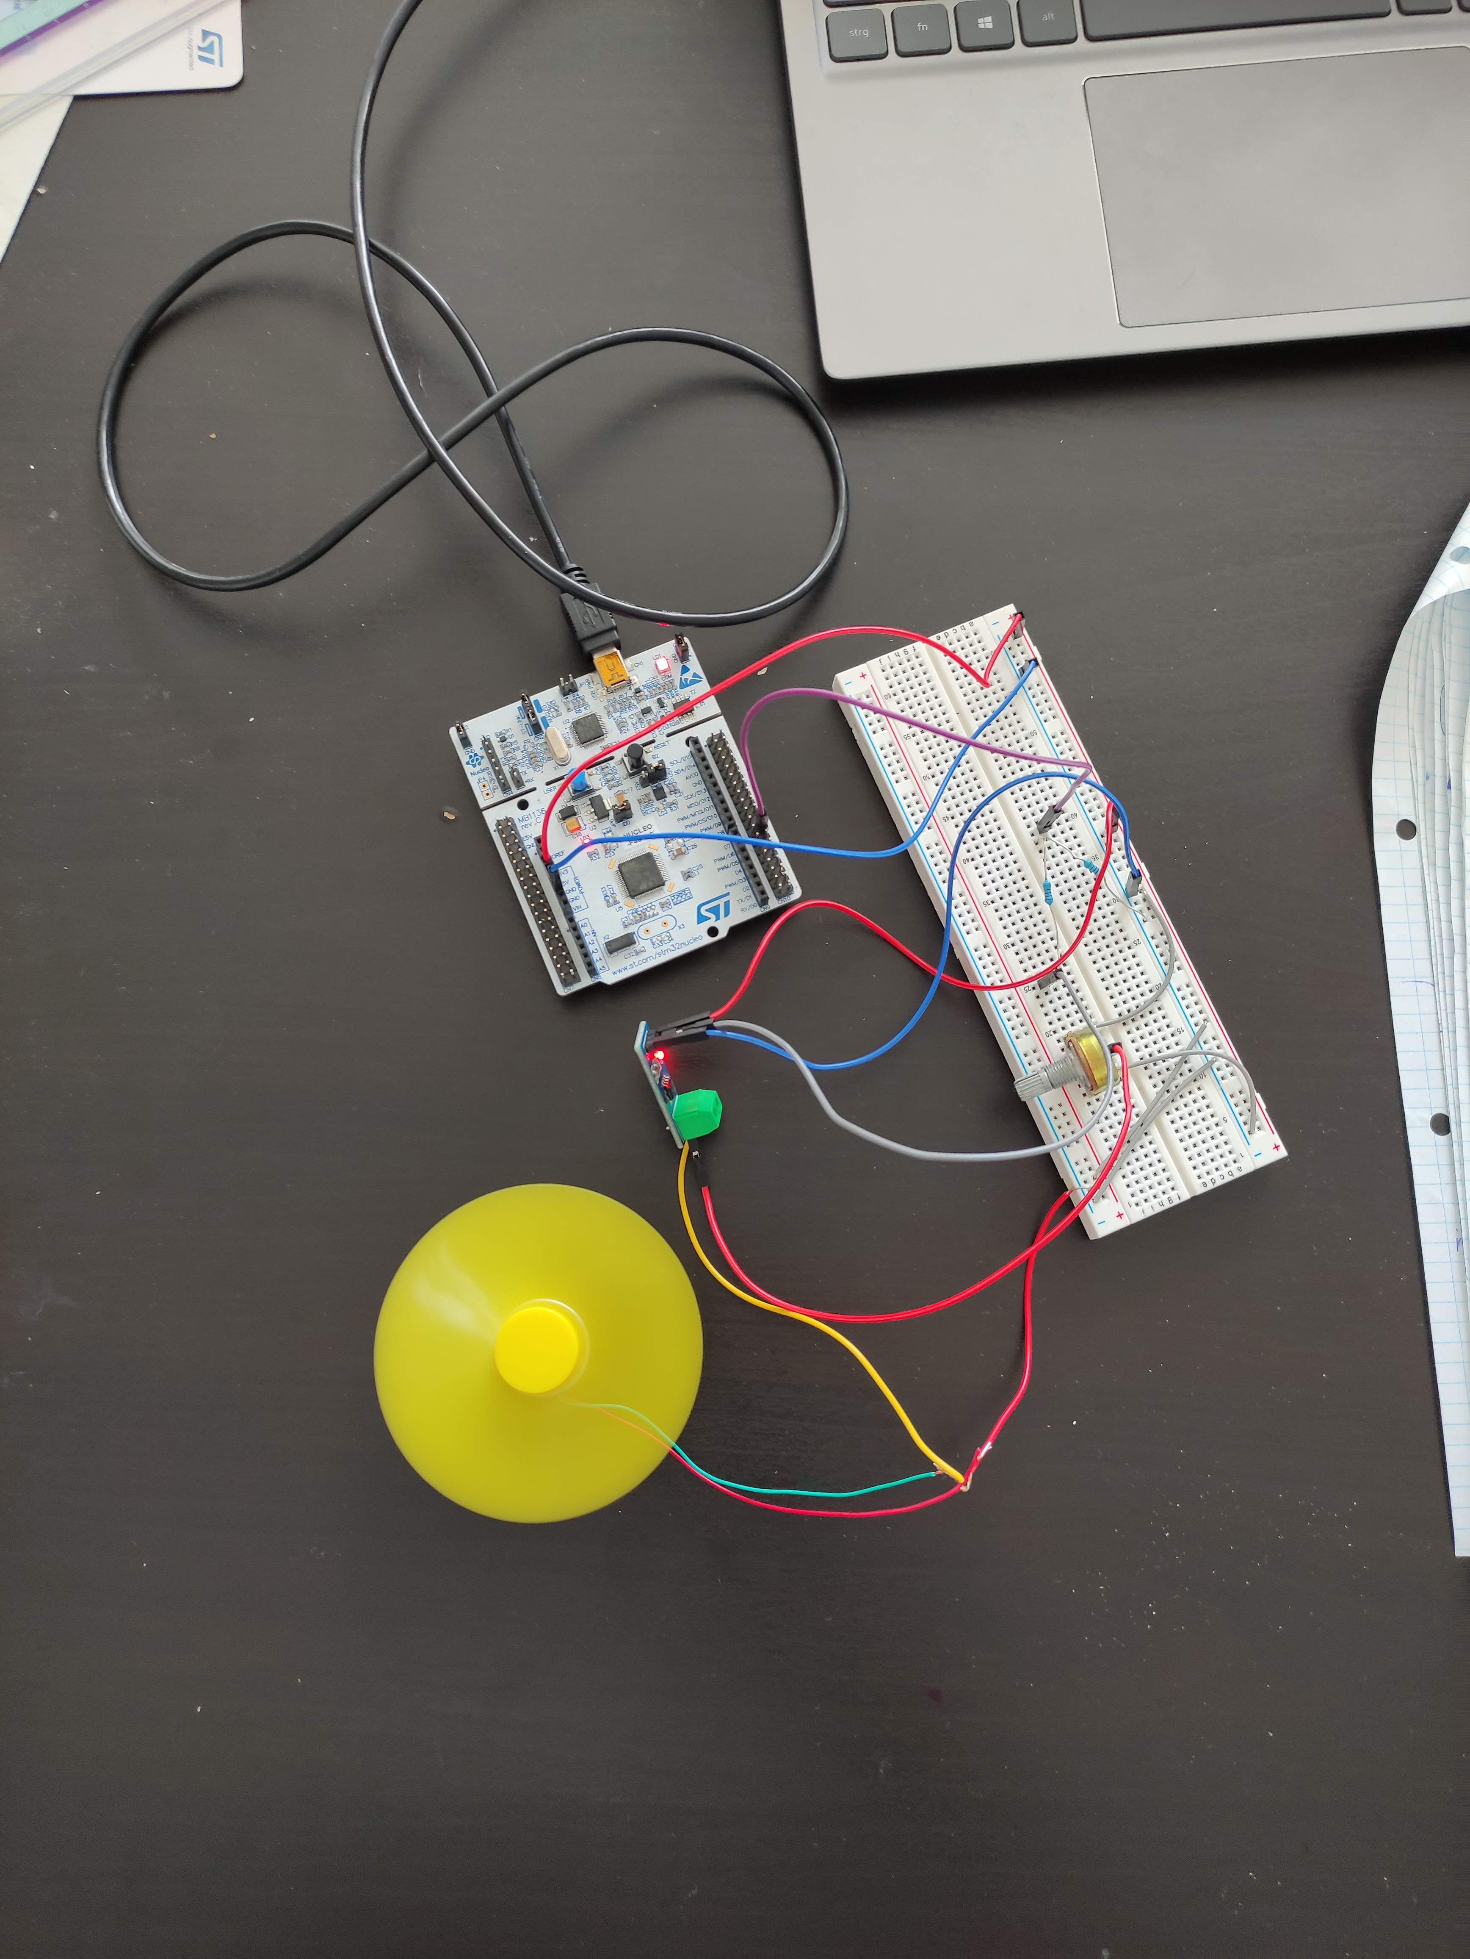
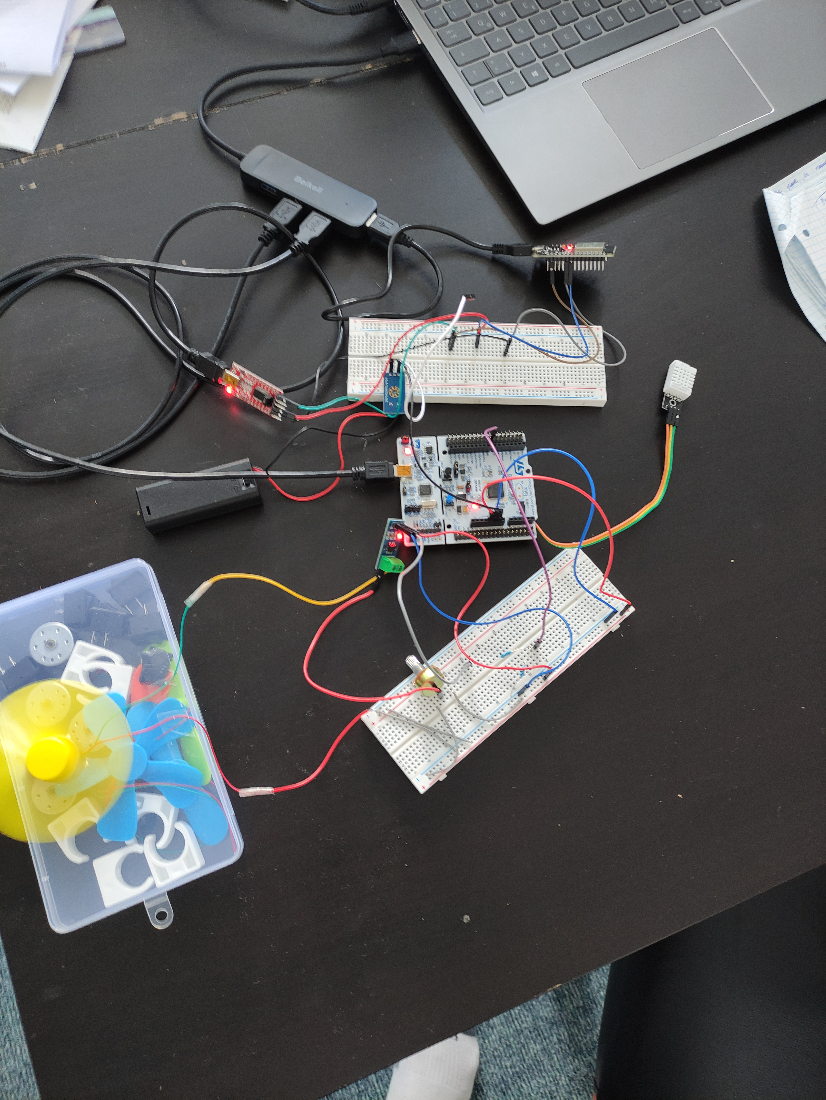
Timeline
Sensors Readings
Getting temperature, voltage, and current sensors readings using STM32-microcontroller.
Transmitting the read values to ESP32
Transmit the sensor reading values from STM32 to ESP32 using UART protocol.
Cloud python code
Create the cloud code using PAHO liberary.
Now
Next :………
Publish the voltage current and temperature sensors reading. Subscribe to another topics.

Slide 13




Thank you

